Slide 1
Bluestock Mutual Fund Analytics Project
Name:K.Vasavi Domain: Data Analytics & Finance

Slide 2
PROBLEM STATEMENT
Analyze mutual fund performance, risk, and investor behavior using data-driven techniques.

Slide 3
OBJECTIVE
Analyze NAV trends
Evaluate fund performance
Study investor behavior
Build dashboards

Slide 4
DATA SOURCES
NAV Data
SIP Inflows
Transactions
Portfolio Holdings

Slide 5
ARCHITECTURE
[ CSV Files ]
↓
[ Python ETL ]
↓
[ SQLite DB ]
↓
[ Analysis Layer ]
↓
[ Risk + Performance Metrics ]
↓
[ Visualization ]
↓
[ Dashboards ]
↓
[ Reports + PPT + GitHub ]

Slide 6
EDA INSIGHTS
SIP growth increasing
AUM dominated by SBI
Market volatility during 2023–2024

Slide 7
PERFORMANCE METRICS
Sharpe Ratio
Alpha
Beta
CAGR

Slide 8
RISK ANALYSIS
VaR (95%)
CVaR
Drawdown

Slide 9
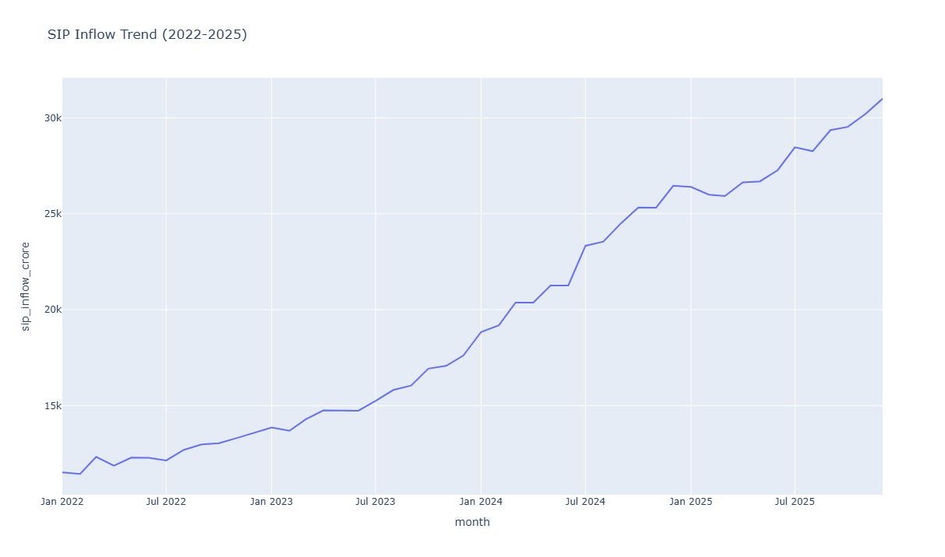
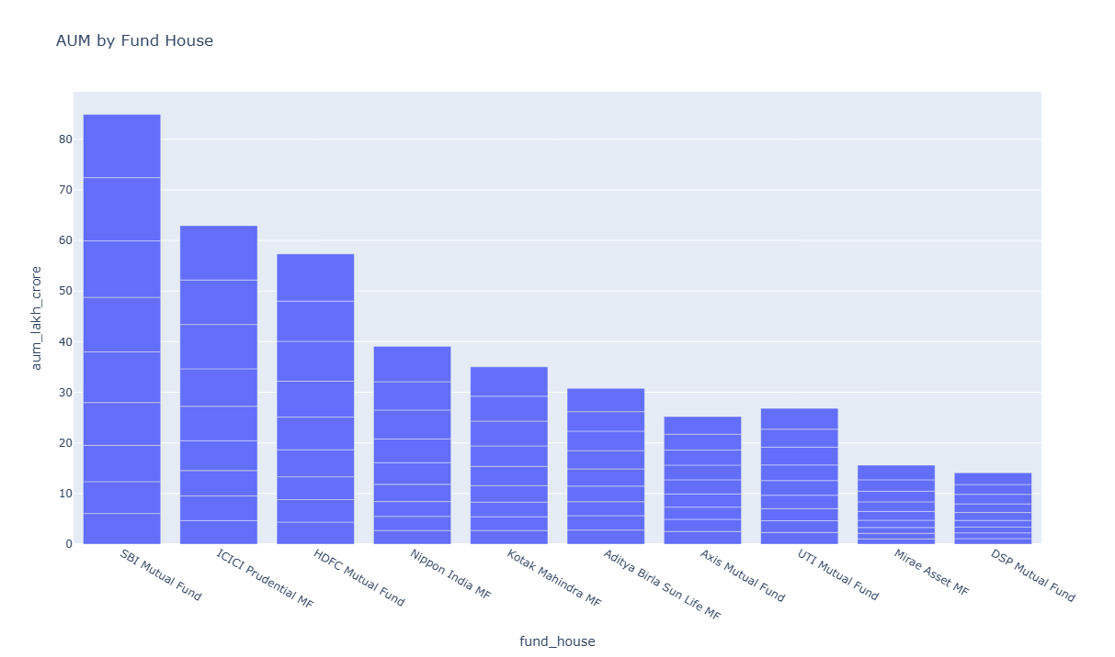
DASHBOARD (PAGE 1)

Slide 10
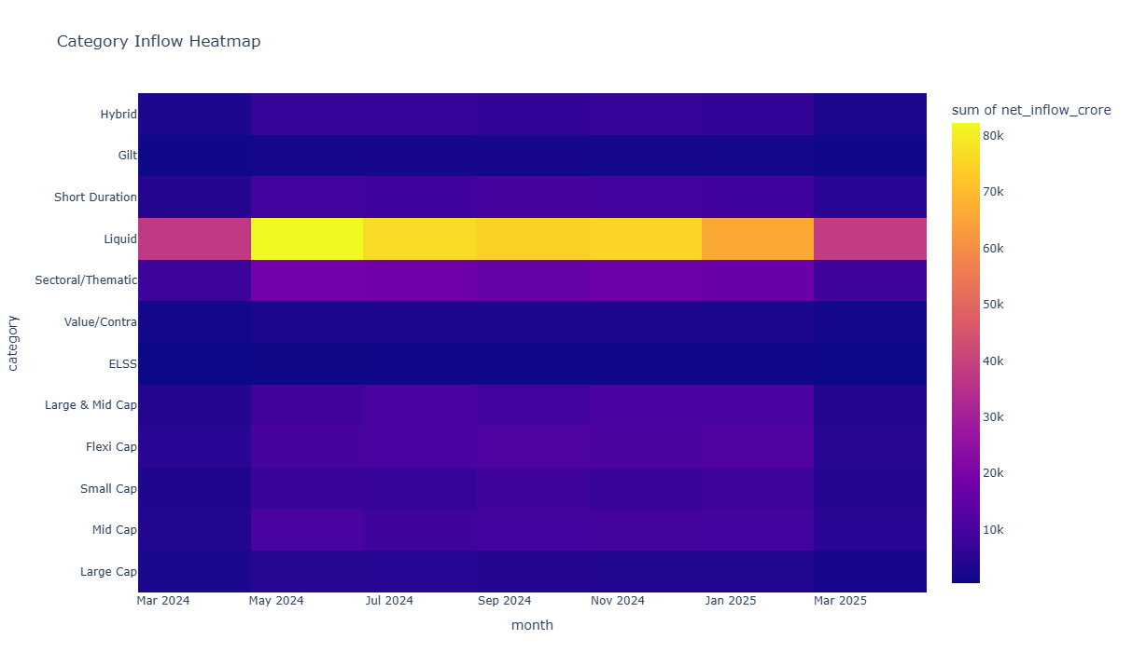
DASHBOARD (PAGE 2)

Slide 11
KEY FINDINGS
SBI dominates market
SIP inflows growing
Equity funds outperform debt

Slide 12
THANK YOU

